Slide 1
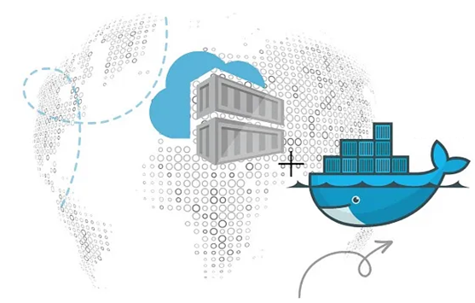
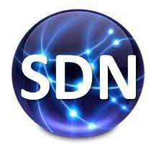
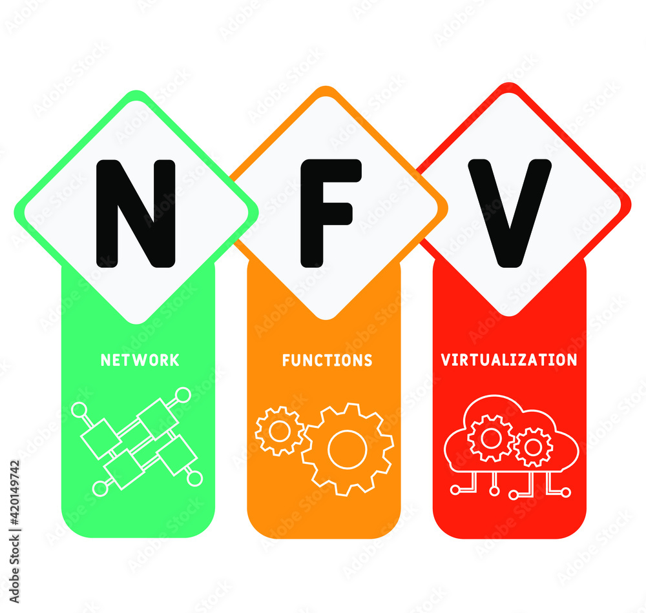
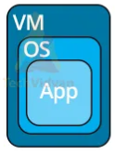
PDS
Computer Vision
Chapter 20:
Simplifying Containerization with Docker Run Command
https://github.com/siagianp
https://github.com/amelcharolinesgn2/IoT_simulator-mqtt-NodeRed
https://www.youtube.com/@AmelOline/videos
Notes:
https://medium.com/buildpiper/simplifying-containerization-with-docker-run-command-2f74e114f42a
https://github.com/IBA-Group-IT/IoT-data-simulator
https://www.bevywise.com/blog/docker-mqtt-broker-easy-service-manageability/

Slide 2
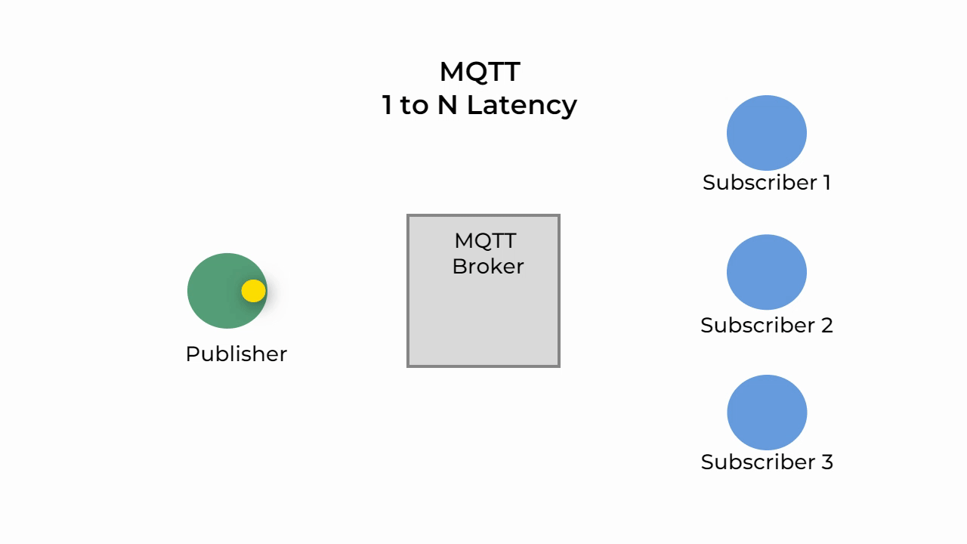
MQTT (Message Queue Telemetry Transport)
What is Publisher-subscriber
The Publisher-Subscriber model, unlike the Client-Server, the client that sends the message (Publisher) is unaware of the existence of the client that receives the message (Subscriber). Clients do not connect to each other directly they connect to the Broker which is responsible for routing the messages. The MQTT Broker uses Topics for routing messages to the exact subscribed client.
Notes:
https://medium.com/nerd-for-tech/everything-to-know-about-mqtt-message-queue-telemetry-transport-acbf32d1b761

Slide 3
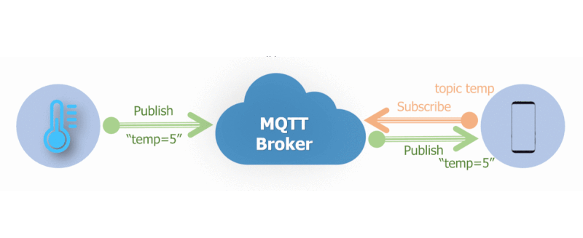
What is a Topic
MQTT Topic is a string that is used to route messages. We can create multiple hierarchies by using slash /, similar to a URL. A Publisher client can publish a message on a topic and a Broker delivers the message to all the Clients that has subscribed to that topic.
Topic :
sensor/1/temperature
sensor/2/humidity
software-update/android/14/
software-update/android/14/2
software-update/ios/17
software-update/ios/17/

Slide 4
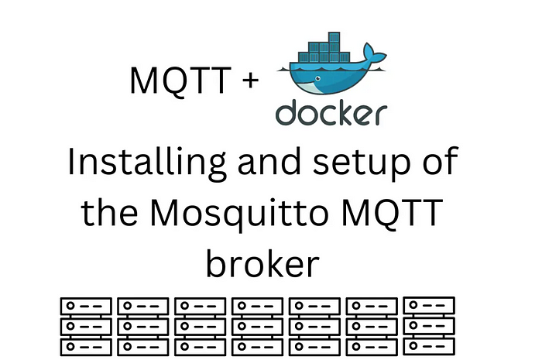
Tutorial : Setting up an Mosquitto MQTT With Docker
Notes:
Tutorial : Setting up an Mosquitto MQTT With Docker
https://medium.com/@krisnawhy300/tutorial-setting-up-an-mosquitto-mqtt-with-docker-0c37d8f7cbe7
https://github.com/4nx/mosquitto

Slide 5
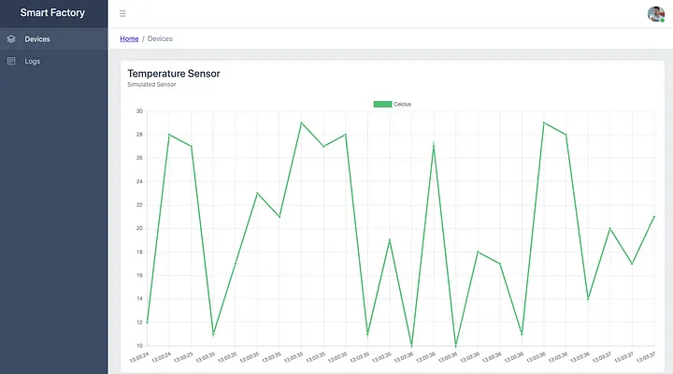
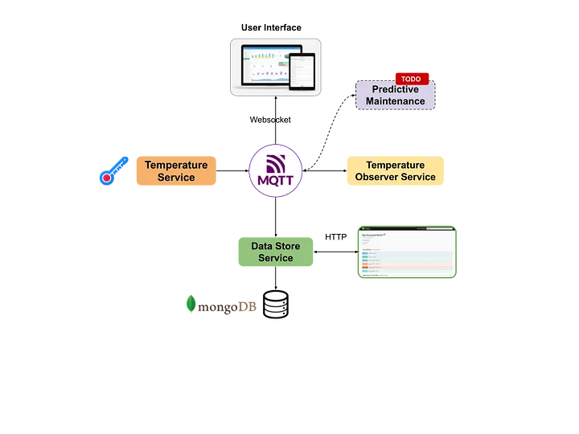
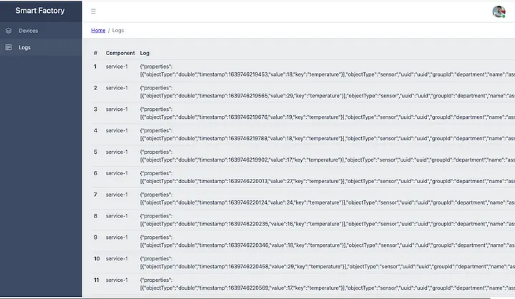
Creating a Simple IoT Project
Notes:
Quick Start
Use Case
System Architecture
Required Technologies
System Components
MQTT Broker Configuration
IoT Data Model Design
Simulated IoT Sensor Implementation
Data Processing&Observer Service Implementation
Data Storing&Requesting Service Implementation
User Web Interface Implementation
Predictive Maintenance Service Implementation (TODO)
6. Future Works
https://medium.com/nerd-for-tech/creating-a-simple-iot-project-590342f6f904
https://github.com/cemakpolat/simple-iot-project
https://thingsboard.io/docs/samples/raspberry/temperature/
https://github.com/fahdarhalai/IoTTempMonitoringSystem

Slide 6
PDS
SDN
NFV
Computer Vision
Notes:
https://medium.com/buildpiper/simplifying-containerization-with-docker-run-command-2f74e114f42a
https://github.com/IBA-Group-IT/IoT-data-simulator
https://www.bevywise.com/blog/docker-mqtt-broker-easy-service-manageability/

Slide 7
how to run docker
https://docs.docker.com/get-started/docker-concepts/the-basics/what-is-a-container/
https://docs.docker.com/reference/cli/docker/container/run/
https://docs.docker.com/get-started/workshop/02_our_app/
Notes:
https://github.com/docker/getting-started-todo-app

Slide 8
https://docs.docker.com/get-started/workshop/02_our_app/
Prerequisites
You have installed the latest version of Docker Desktop.
You have installed a Git client.
You have an IDE or a text editor to edit files. Docker recommends using Visual Studio Code.
https://github.com/siagianp/IoT-Data_Simulation1/blob/main/IoT-data-simulator1.zip
Notes:
https://docs.docker.com/get-started/workshop/02_our_app/

Slide 9
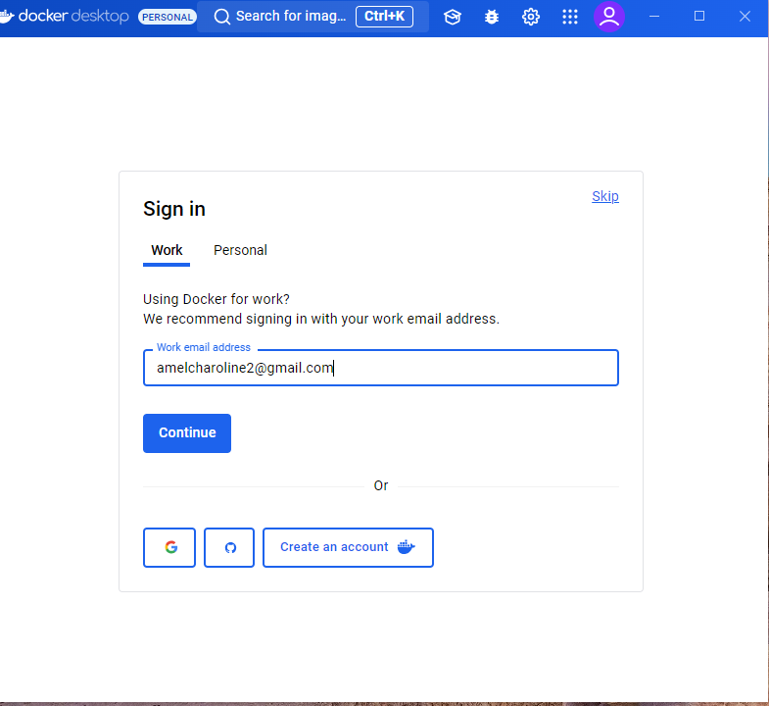
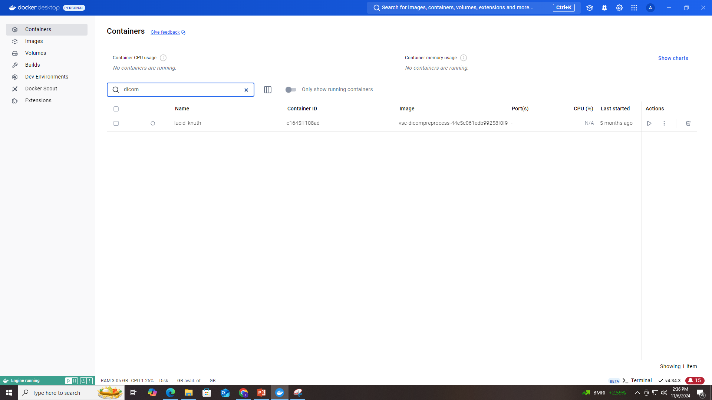
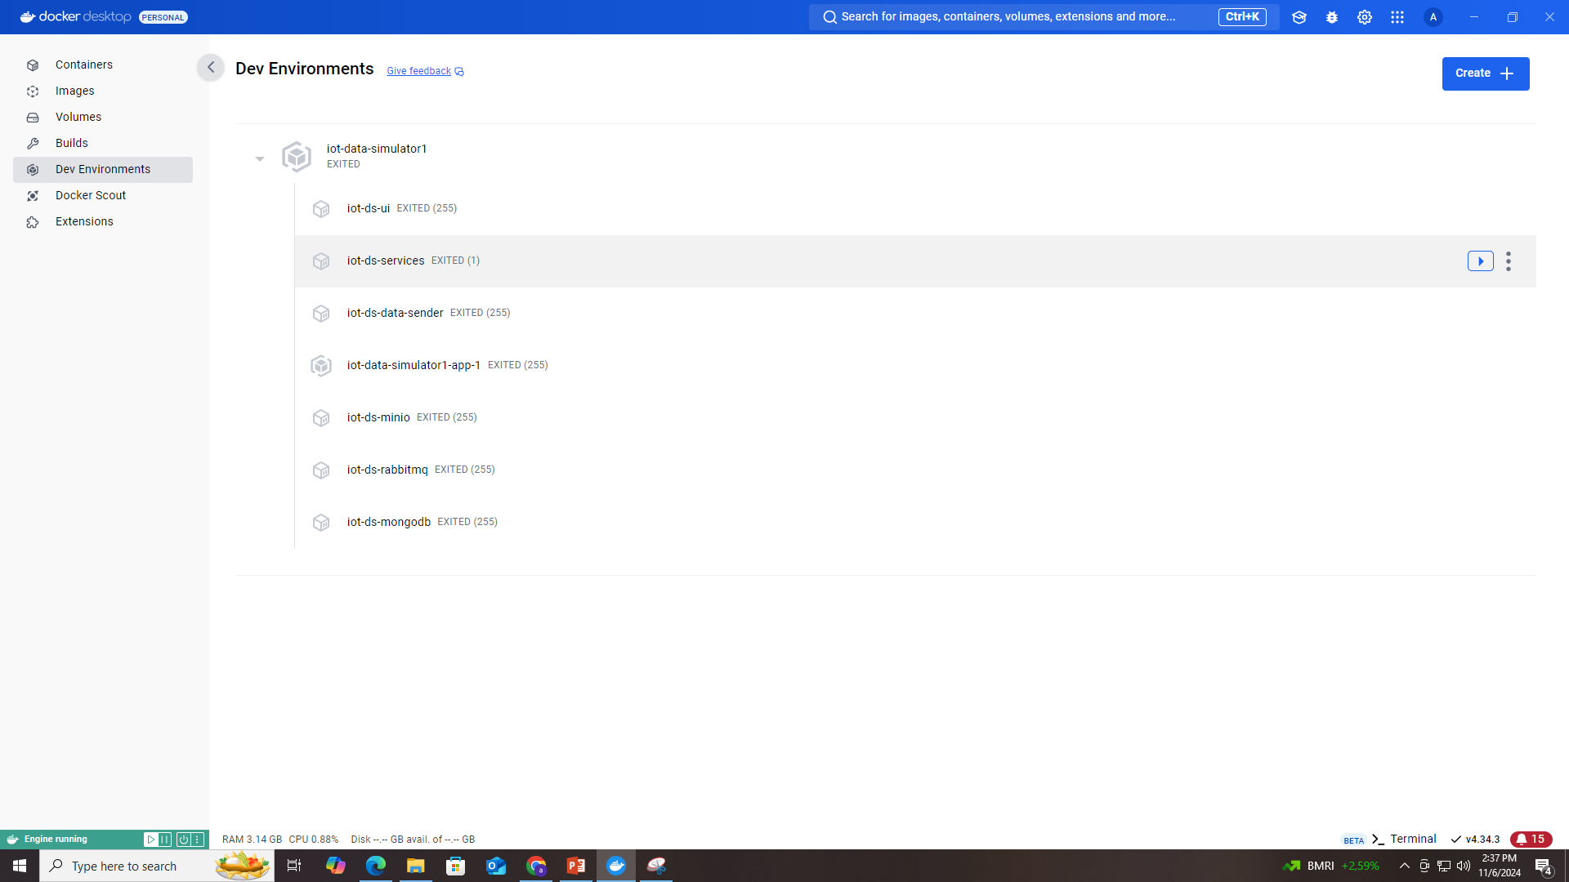

Slide 10
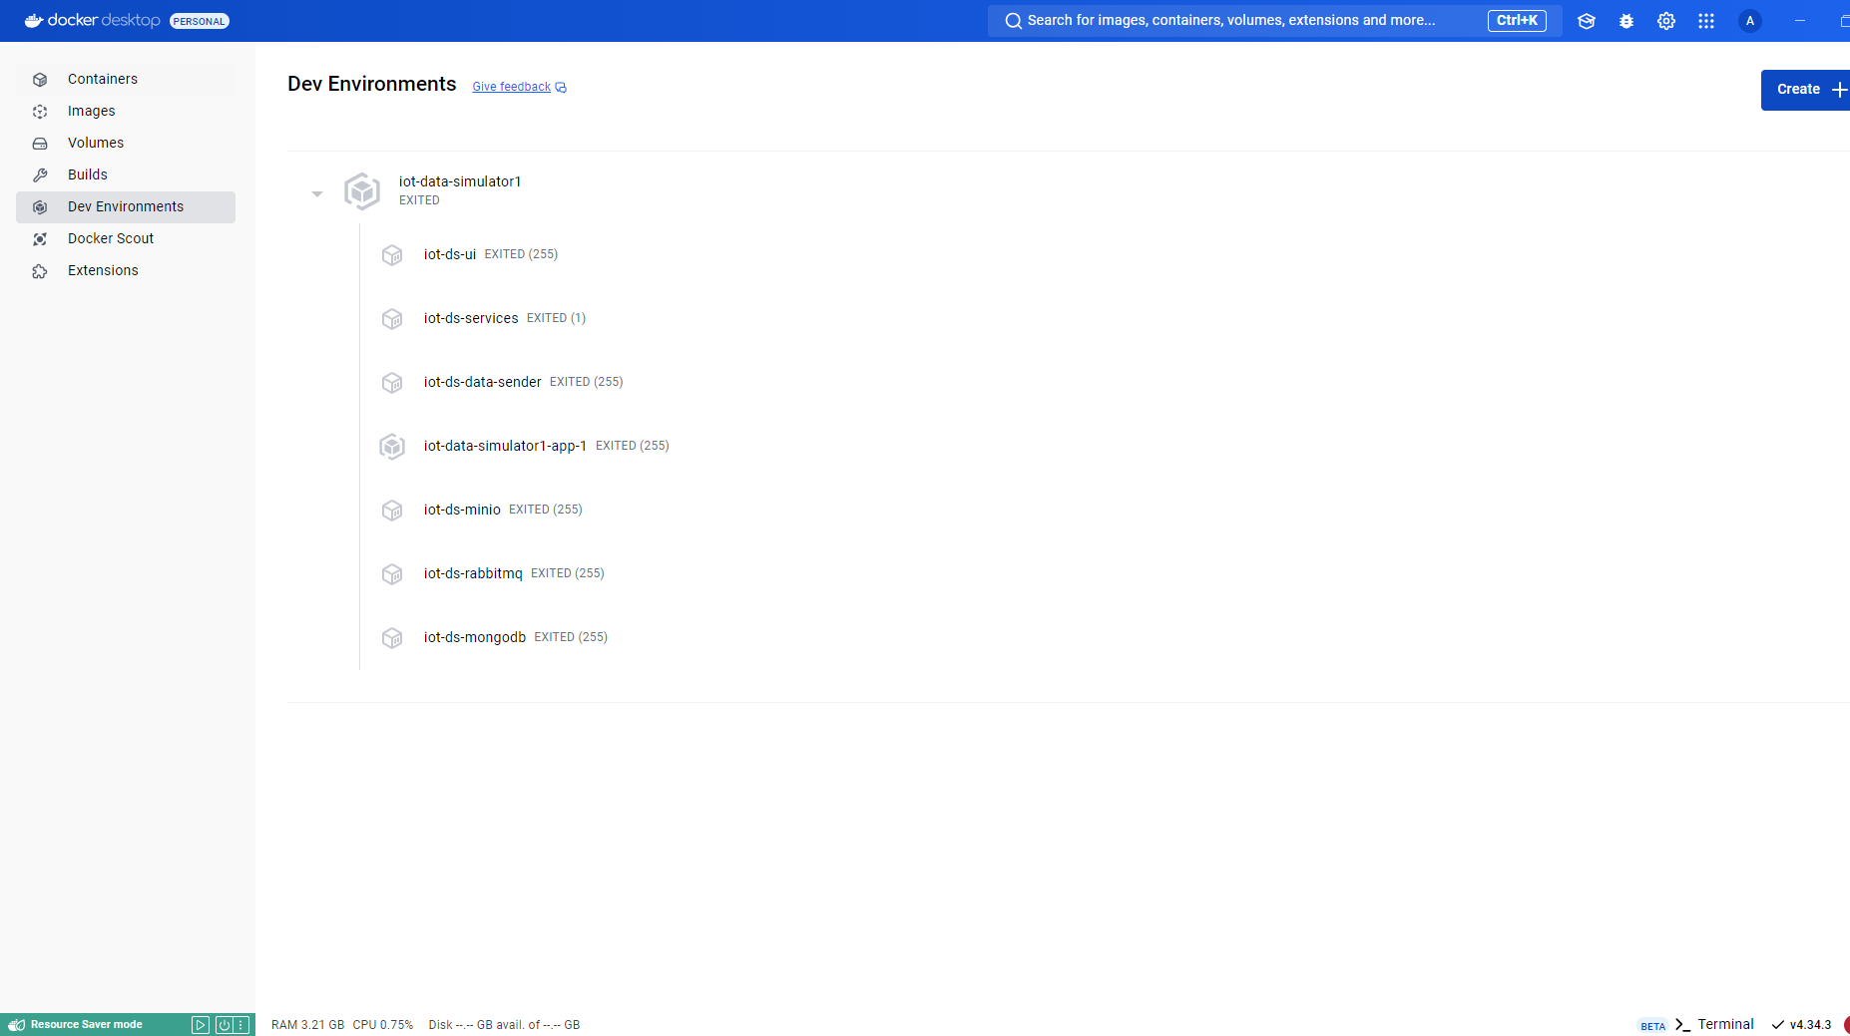

Slide 11
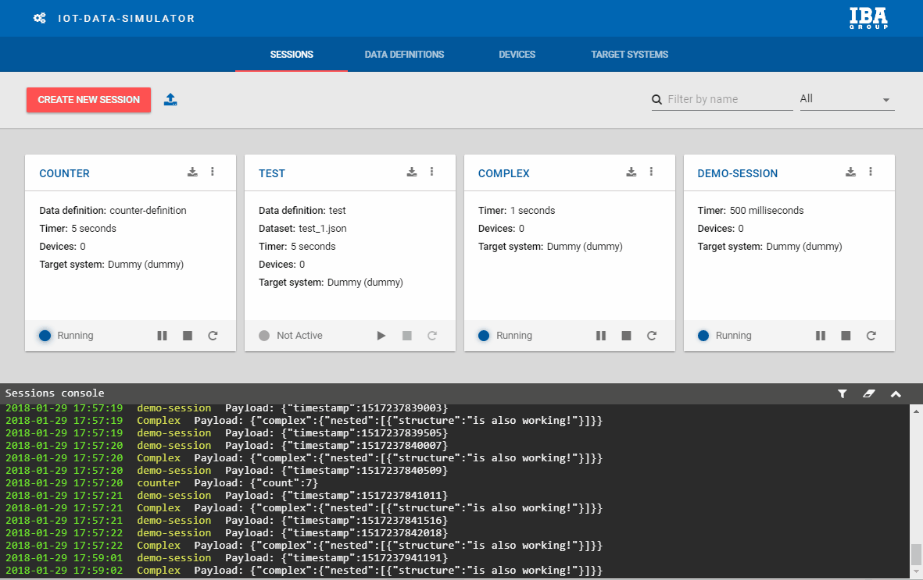
Notes:
https://github.com/IBA-Group-IT/IoT-data-simulator?tab=readme-ov-file
https://github.com/tribp
https://github.com/tribp/DSMR-Fluvius-S1-port-simulator
https://github.com/tribp/Iot-Sim-in-Docker4AWS

Slide 12
Git
Notes:
https://www.niagahoster.co.id/blog/git-tutorial-dasar/

Slide 13
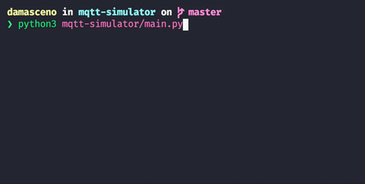
MQTT Simulator
Notes:
https://github.com/tribp/Iot-Sim-in-Docker4AWS
https://github.com/mgarciap/iot-sensor-simulator
https://github.com/DamascenoRafael/mqtt-simulator
https://github.com/DamascenoRafael/mqtt-simulator

Slide 14
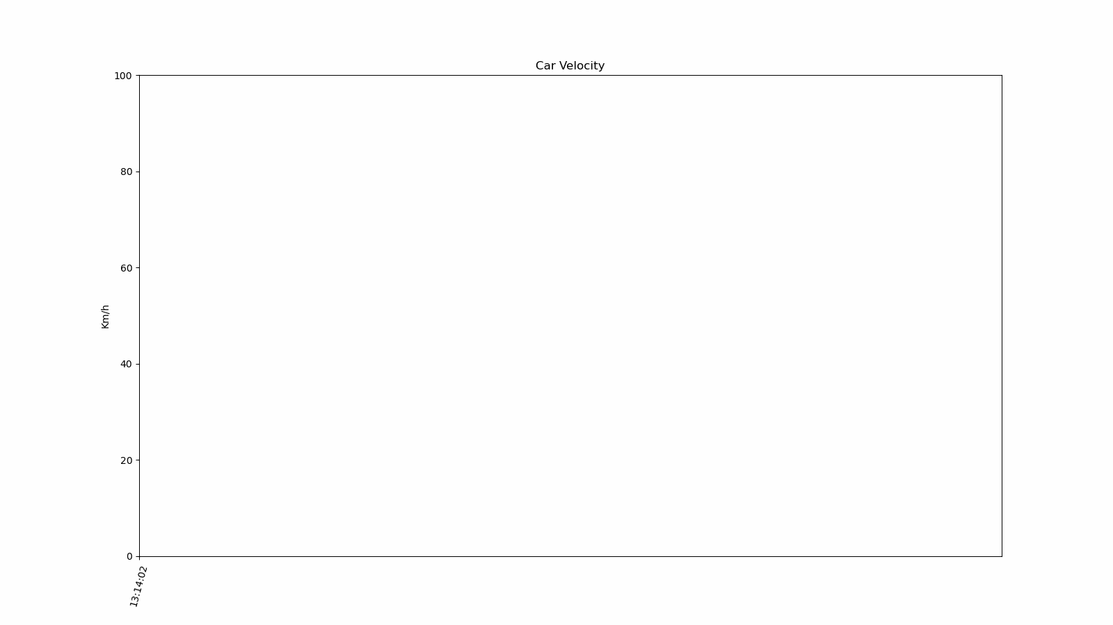
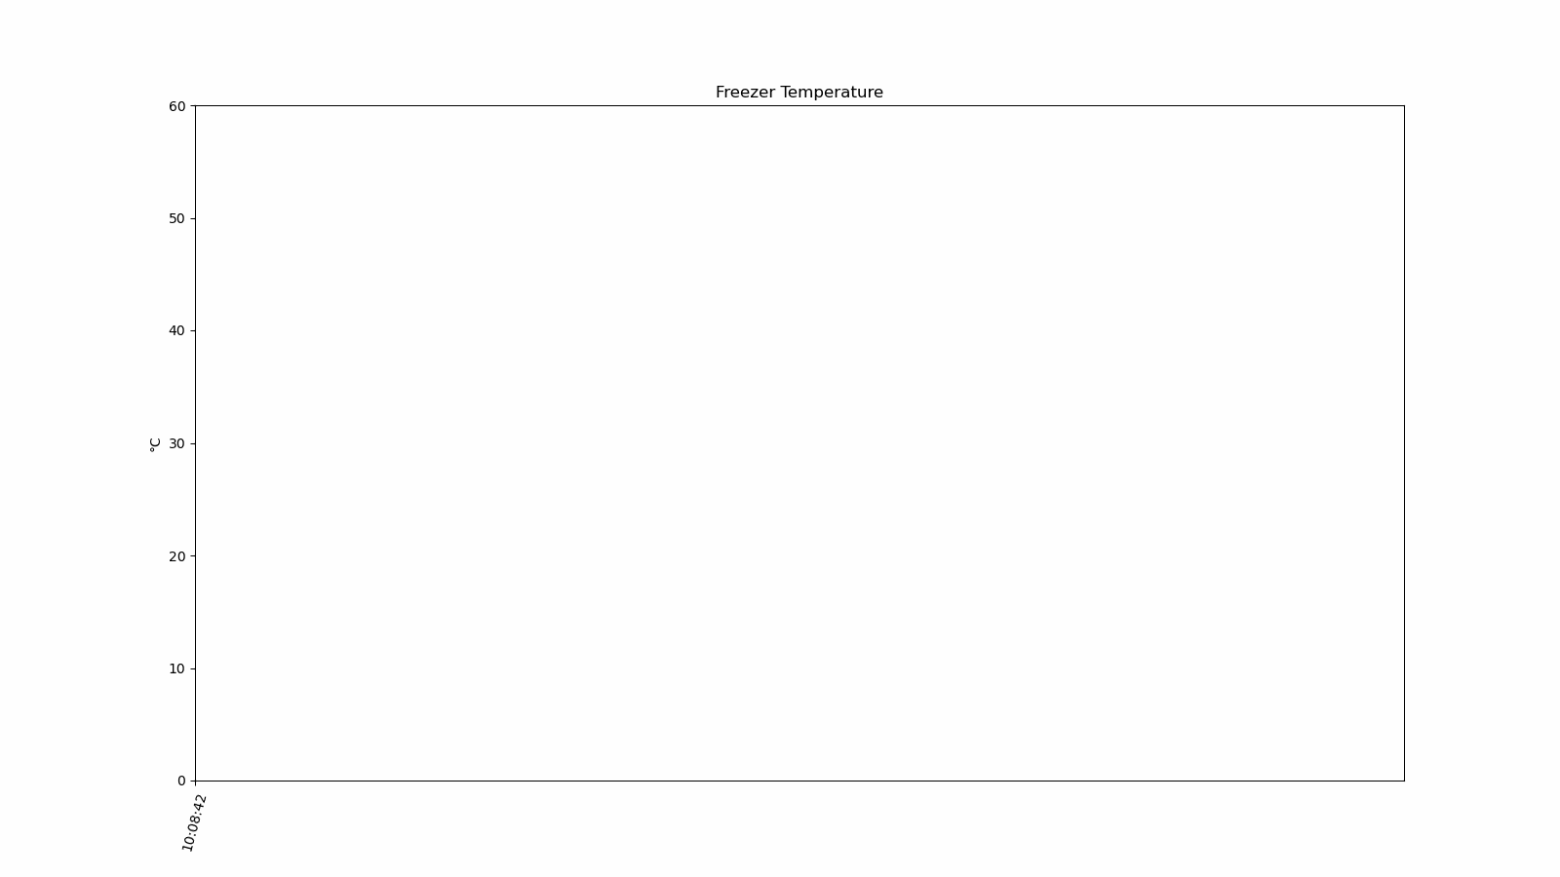
MQTT Simulator
Notes:
https://github.com/tribp/Iot-Sim-in-Docker4AWS
https://github.com/mgarciap/iot-sensor-simulator
https://github.com/DamascenoRafael/mqtt-simulator
https://github.com/DamascenoRafael/mqtt-simulator
https://github.com/fahdarhalai/IoTTempMonitoringSystem

Slide 15
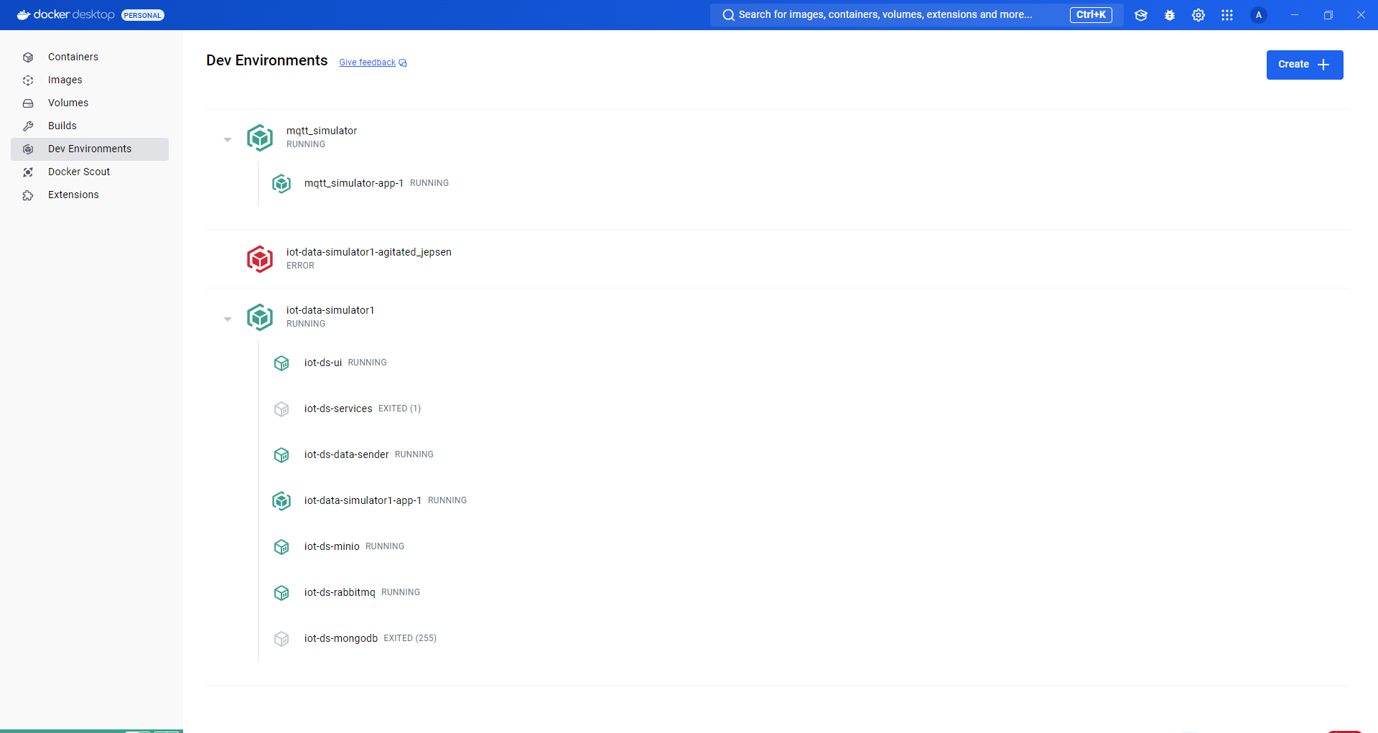
Notes:
https://github.com/DamascenoRafael/mqtt-simulator

Slide 16
Prerequisites
Python 3 (with pip)
Installing Dependencies
To install all dependencies with a virtual environment:
python3 -m venv venv_IoT
source venv/bin/activate
pip3 install -r requirements.txt
!Pip3 install paho-mqtt==1.5.0

Slide 17
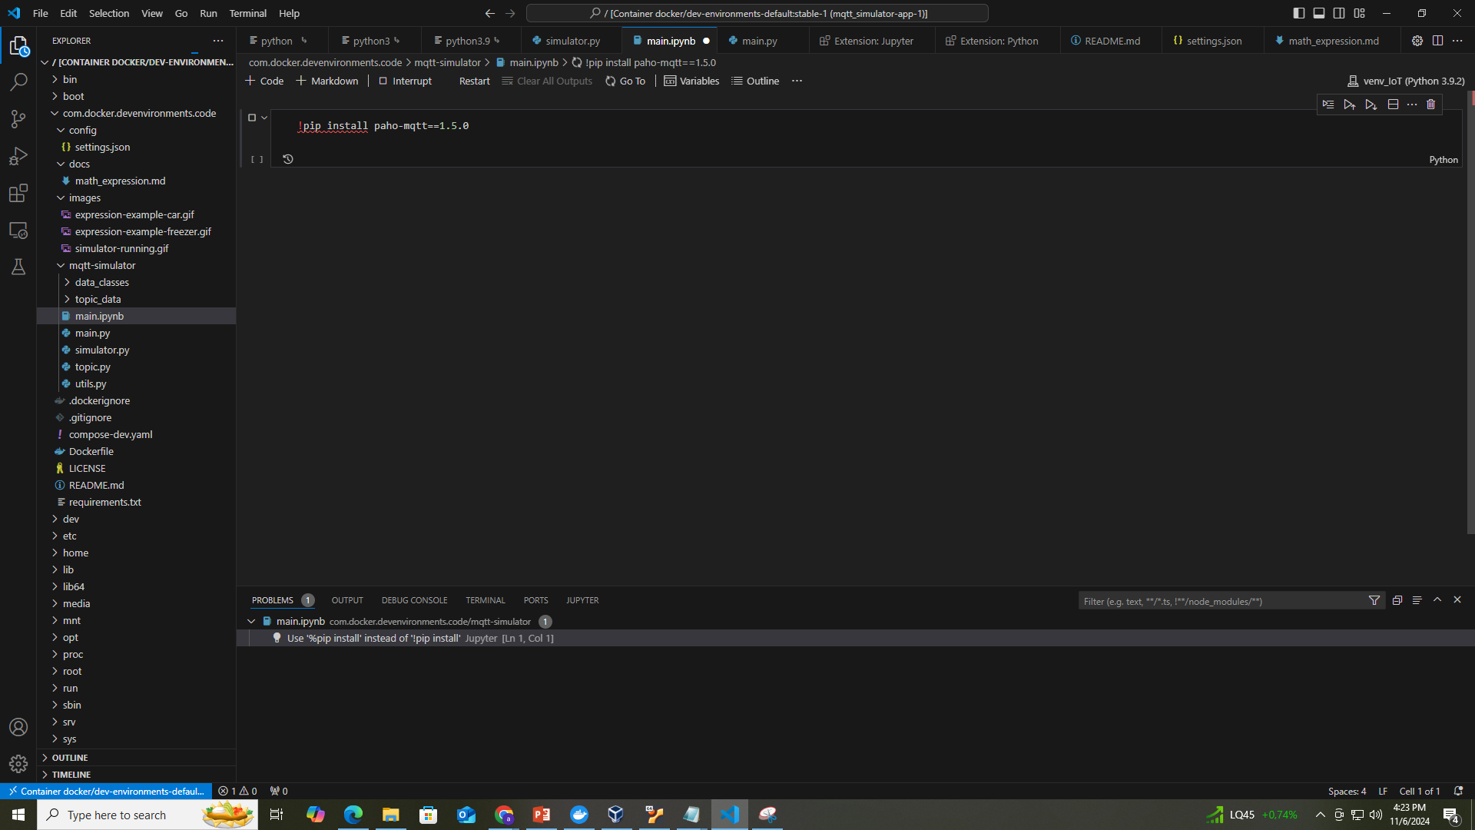
Notes:
https://github.com/DamascenoRafael/mqtt-simulator
https://github.com/mgarciap/iot-sensor-simulator

Slide 18
Creating a Simple IoT Project Simple IoT temperature simulation docker
Notes:
https://medium.com/nerd-for-tech/creating-a-simple-iot-project-590342f6f904
https://github.com/cemakpolat/simple-iot-project.git
https://github.com/Fillo22/IoT-Monitoring
https://docs.aws.amazon.com/iot/latest/developerguide/mqtt.html
https://github.com/phyunsj/iot-device-simulator-1-mqtt/blob/master/iot-simulator-mqtt.gif

Slide 19
Thank you!
PDS
SDN
NFV
Computer Vision
Thank you For being a great class!
https://github.com/siagianp
https://github.com/amelcharolinesgn2/IoT_simulator-mqtt-NodeRed
https://www.youtube.com/@AmelOline/videos
Notes:
https://medium.com/buildpiper/simplifying-containerization-with-docker-run-command-2f74e114f42a
https://github.com/IBA-Group-IT/IoT-data-simulator
https://www.bevywise.com/blog/docker-mqtt-broker-easy-service-manageability/

Slide 20
Thank you!
Thank you For being a great class!
PDS
Computer Vision
https://github.com/siagianp
https://www.youtube.com/@AmelOline/videos

